Slide 1



Department of Computer Science and Engineering
Mini Project (BCS586)
Review – 0
DROWSINESS DETECTION FOR DRIVERS
Batch No.: 2025_CSE_08
AKSHAY KRSHNA 1KS22CS009
ADITYA S 1KS22CS005
DARSHAN D GOWDA 1KS22CS037
ABHISHEK A 1KS22CS002
Guided by
Mr.Abhilash L Bhat
Assistant Professor

Slide 2
Contents
Overview
Goals
Applications
Requirement Specifications
Control Flow
Data Set
References

Slide 3
Overview
Driver fatigue is a significant factor in a large number of vehicle accidents. Thus, driver Drowsiness detection has been considered a major potential area so as to prevent a huge number of sleep induced road accidents.
The Driver Drowsiness Detection System aims to enhance road safety by detecting drowsiness through eye and facial analysis.
Using a webcam and software tools like Python, OpenCV, and Dlib, the system captures video input, preprocesses frames (converting to grayscale and applying Gaussian blur), and detects faces and eyes.
By calculating the Eye Aspect Ratio (EAR) and setting a threshold, the system triggers alerts when drowsiness is detected. Testing under various conditions ensures accuracy, and documentation includes a report and presentation for project defense.

Slide 4
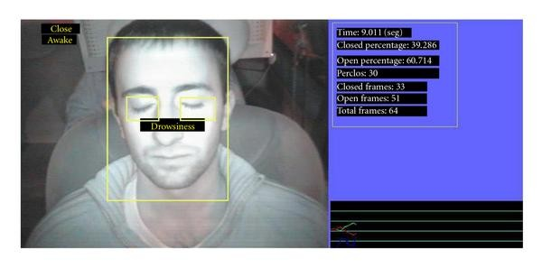
Goals
Enhance Road Safety: Prevent accidents caused by driver fatigue.
Real-Time Monitoring: Analyse eye states using image processing techniques.
Increase Detection Accuracy: Improve precision through advanced algorithms.
Alert Mechanism: Provide timely audio or visual alerts for drowsiness.
Research and Development: Explore IoT and machine learning for enhanced system capabilities.
Notes:
Arduino is an open-source product, software/hardware which is accessible and flexible to customers.
Arduino is flexible because of offering variety of digital and analog pins, SPI and PWM outputs.
Arduino is easy to use, connected to a computer via a USB and communicates using serial protocol.
Inexpensive, around 500 rupees per board with free authoring software.
Arduino has growing online community where lots of source code is available for use, share and post examples for others to use too. Arduino is Cross-platform, which can work on Windows, Mac or Linux platforms.
Arduino follows Simple, clear programming environment as C language.

Slide 5
Applications
Accident Prevention: Reduces the risk of accidents caused by drowsy driving by providing timely alerts to drivers.
Commercial Fleet Management: Enhances safety for long-haul truck drivers and delivery services by monitoring driver alertness during extended hours.
Smart Vehicle Integration: Integrates with advanced driver-assistance systems (ADAS) to improve overall vehicle safety and performance.
Insurance Benefits :Potentially lowers insurance premiums for vehicles equipped with drowsiness detection systems due to reduced accident risk.
Public Transportation Safety: Ensures the safety of passengers in buses and taxis by monitoring driver fatigue levels.
Research and Development: Provides data for further studies on driver behavior and fatigue, contributing to advancements in transportation safety technologies
Notes:
Arduino is an open-source product, software/hardware which is accessible and flexible to customers.
Arduino is flexible because of offering variety of digital and analog pins, SPI and PWM outputs.
Arduino is easy to use, connected to a computer via a USB and communicates using serial protocol.
Inexpensive, around 500 rupees per board with free authoring software.
Arduino has growing online community where lots of source code is available for use, share and post examples for others to use too. Arduino is Cross-platform, which can work on Windows, Mac or Linux platforms.
Arduino follows Simple, clear programming environment as C language.

Slide 6
Requirement Specifications
Functional Requirements: Image Capture: Use a webcam or camera to capture driver images continuously at 20fps.Face Detection: Implement algorithms to detect the driver's face .Eye Detection: Identify eye regions and calculate the Eye Aspect Ratio (EAR) to assess drowsiness. Alert Mechanism: Trigger audio or visual alerts when drowsiness is detected.
Non-Functional Requirements: Reliability: Ensure accurate detection of drowsiness to promote driver safety. Real-Time Response: Provide immediate alerts to avoid delays in detection. Unobtrusive Operation: The system should be transparent and not distract the driver. Economical: Design the system to be cost-effective for widespread implementation. Flexibility: Accommodate various user physical attributes for effectiveness.
Constraints: Power Consumption: Operate efficiently on limited power sources available in vehicles.
Technology Requirements: Utilize software tools such as Python, OpenCV, and Dlib for image processing and analysis.
Notes:
Arduino is an open-source product, software/hardware which is accessible and flexible to customers.
Arduino is flexible because of offering variety of digital and analog pins, SPI and PWM outputs.
Arduino is easy to use, connected to a computer via a USB and communicates using serial protocol.
Inexpensive, around 500 rupees per board with free authoring software.
Arduino has growing online community where lots of source code is available for use, share and post examples for others to use too. Arduino is Cross-platform, which can work on Windows, Mac or Linux platforms.
Arduino follows Simple, clear programming environment as C language.

Slide 7
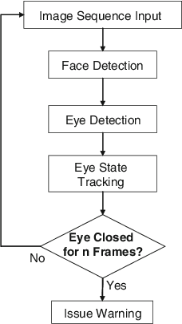
Control Flow
Notes:
Arduino is an open-source product, software/hardware which is accessible and flexible to customers.
Arduino is flexible because of offering variety of digital and analog pins, SPI and PWM outputs.
Arduino is easy to use, connected to a computer via a USB and communicates using serial protocol.
Inexpensive, around 500 rupees per board with free authoring software.
Arduino has growing online community where lots of source code is available for use, share and post examples for others to use too. Arduino is Cross-platform, which can work on Windows, Mac or Linux platforms.
Arduino follows Simple, clear programming environment as C language.

Slide 8
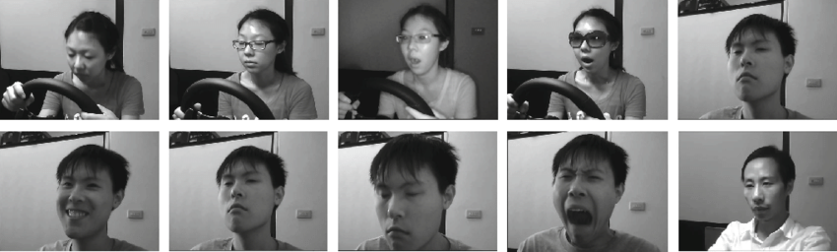
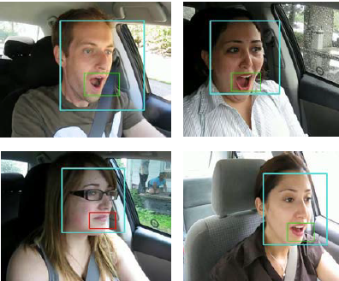
Data Set
YawDD Dataset: Videos from dashboard cameras featuring diverse drivers. Used for training and evaluating drowsiness detection systems.
Closed Eyes in the Wild (CEW) Dataset: Contains images of 2,423 subjects with open and closed eyes. Sourced from the Labeled Face in the Wild dataset.
Drowsiness Detection Dataset (Roboflow): Collection of images depicting "drowsy" and "awake" facial expressions in a vehicle.
Driver Drowsiness Dataset (D3S):Includes videos and frames of various states (eye closed, yawning, etc.) for training purposes.
Notes:
Arduino is an open-source product, software/hardware which is accessible and flexible to customers.
Arduino is flexible because of offering variety of digital and analog pins, SPI and PWM outputs.
Arduino is easy to use, connected to a computer via a USB and communicates using serial protocol.
Inexpensive, around 500 rupees per board with free authoring software.
Arduino has growing online community where lots of source code is available for use, share and post examples for others to use too. Arduino is Cross-platform, which can work on Windows, Mac or Linux platforms.
Arduino follows Simple, clear programming environment as C language.

Slide 9
References
Sun, Y., Wu, C., Zhang, H., Zhang, Y., Li, S., & Feng, H. (2021). Extraction of Optimal Measurements for Drowsy Driving Detection Considering Driver Fingerprinting Differences. Journal of Advanced Transportation, 1–17. http://dx.doi.org/10.1155/2021/5546127.
J. S., & Smitha P. S. (2014). Driver Drowsiness Detection System. IOSR Journal of VLSI and Signal Processing, 4(1), 34–37. http://dx.doi.org/10.9790/4200-04113437.Gargano, I. E. (2022).
Model-Based Validation of Driver Drowsiness Detection System for ADAS. Master's thesis, Alma Mater Studiorum - Università di Bologna. http://amslaurea.unibo.it/25716/.
Svensson, U. (2004). Blink Behaviour Based Drowsiness Detection: Method Development and Validation. Swedish National Road and Transport Research Institute. http://www.vti.se.
Abas, A. B. (2011). Non-Intrusive Driver Drowsiness Detection System. Thesis, University of Bradford. http://hdl.handle.net/10454/5521.
Notes:
Arduino is an open-source product, software/hardware which is accessible and flexible to customers.
Arduino is flexible because of offering variety of digital and analog pins, SPI and PWM outputs.
Arduino is easy to use, connected to a computer via a USB and communicates using serial protocol.
Inexpensive, around 500 rupees per board with free authoring software.
Arduino has growing online community where lots of source code is available for use, share and post examples for others to use too. Arduino is Cross-platform, which can work on Windows, Mac or Linux platforms.
Arduino follows Simple, clear programming environment as C language.

